Slide 1

What is a natural number?
Notes:
Tell students to get a piece of paper and pen

Slide 2
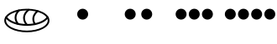
Natural Numbers
0, 1, 2, 3, …
I, II, III, IV, V, …

Slide 3
What is equality?
Is 0 equal to 1?
Is 0 equal to 0?

Slide 4
Equality
A way of grouping numbers.
It does not matter which number from the group we use.
How big is the group of natural numbers that contains 1?
How big is the group of rational numbers (fractions) equal to ½?

Slide 5
Equality Properties
A number m is in the same group as n if m is equal to n.
m
Should a number be in the same group as itself?
Reflexivity Property: A number is equal to itself.

Slide 6
Equality Properties
m
n
A number m is in the same group as n if m is equal to n.
If m is in the same group as n, should n be in the same group as m?
Symmetry Property: For all m and n with m=n, n=m.

Slide 7



Fractions Example
$$\frac{1}{2}$$
$$\frac{2}{4}$$

Slide 8
Equality Properties
m
n
A number m is in the same groups as n if m is equal to n.
p
What property should we have for three numbers?
Transitivity Property: For all m, n and p with m=n and n=p, m=p.

Slide 9












Fractions Example
$$\frac{1}{2}$$
$$\frac{1}{3}$$
$$\frac{2}{4}$$
$$\frac{3}{6}$$
$$\frac{2}{6}$$
$$\frac{3}{9}$$
$$\frac{4}{8}$$
…
$$\frac{4}{12}$$
…
$$\frac{5}{10}$$
$$\frac{5}{15}$$
$$\frac{6}{12}$$
$$\frac{6}{18}$$

Slide 10
Siblingship
Is it reflexive?
Can you be a sibling of yourself?
Is it symmetric?
If Dorina is a sibling of Maxwell, is Maxwell a sibling of Dorina?
Is it transitive?
If Dorina is a sibling of Maxwell and Maxwell is a sibling of Spicey, is Dorina a sibling of Spicey?

Slide 11
Friendship
Is it reflexive?
Can you be your own friend?
Is it symmetric?
If Dorina is a friend of Eleanor, does it mean that Eleanor is a friend of Dorina?
Is it transitive?
If Anya is a friend of Dorina and Dorina is a friend of Eleanor, does it mean that Anya is a friend of Eleanor?

Slide 12
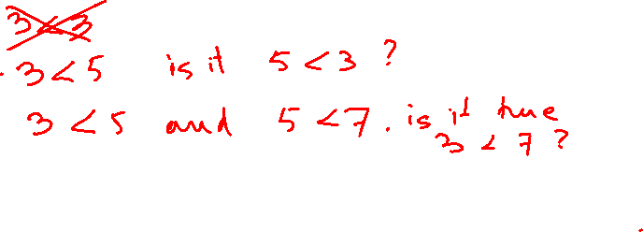
Less Than
Is it reflexive?
Is it symmetric?
Is it transitive?
“Less than” is not reflexive.
“Less than” is not symmetric.
“Less than” is transitive.

Slide 13
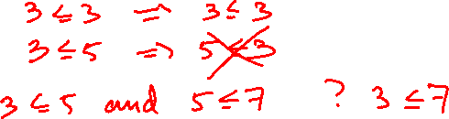
Less or Equal To
Is it reflexive?
Is it symmetric?
Is it transitive?
“Less or equal to” is reflexive.
“Less or equal to” is not symmetric.
“Less or equal to” is transitive.

Slide 14
Has the same birthday as
Is it reflexive?
Is it symmetric?
Is it transitive?
“Has the same birthday as” is reflexive, symmetric and transitive.

Slide 15
Equality
An equality is a relationship that is reflexive, symmetric and transitive.
Can one number be only equal to itself?
Can all the numbers be equal to each other?

Slide 16
Equivalence
An equivalence is a relationship that is reflexive, symmetric and transitive.
Equality is a particular case of equivalence.

Slide 17
Natural Numbers
0, 1, 2, 3, …
Does a natural number even exist?
Is every number followed by some other number?
Is there a number that does not follow any other number?
Can a number be followed by more than one number?

Slide 18
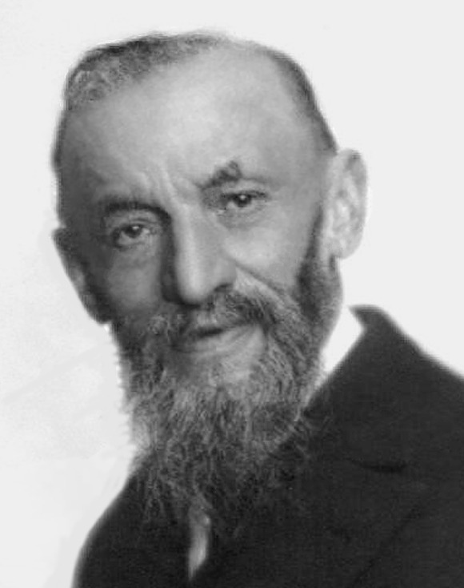
Giuseppe Peano
Italian mathematician (1858 – 1932)
Known for:
First book on mathematical logic (1885)
The formal definition of natural numbers (1889)
Space filling-curves
And many more ….

Slide 19

Peano Curves
Demonstrated that the unit interval (numbers from 0 to 1) “as big as” the unit square.

Slide 20
Axiom 1: is a natural number.
Are there any other natural numbers?
Can we list all the natural numbers?

Slide 21
Axiom 2: For every natural number n, S(n) is a natural number.
How many numbers can we build with only Axiom 2?
None!

Slide 22
Axiom 1: is a natural number.
Axiom 2: For every natural number n, S(n) is a natural number.
Is the natural number 0 the same as ?
How do we call the S( ) ?
What number is S(S( ))?

Slide 23
Axiom 1: is a natural number.
Axiom 2: For every natural number n, S(n) is a natural number.
How many numbers can we build with both Axioms 1 and 2?
Can you build more than we want?

Slide 24
Axiom 1: is a natural number.
Axiom 2: For every natural number n, S(n) is a natural number.
…

Slide 25
Axiom 1: is a natural number.
Axiom 2: For every natural number n, S(n) is a natural number.
Axiom 3: For every natural number n, S(n) = zero is false.
“=” is an equivalence relation.
…

Slide 26
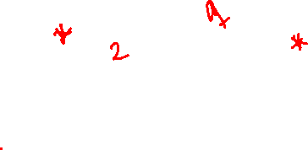
Axiom 1: is a natural number.
Axiom 2: For every natural number n, S(n) is a natural number.
Axiom 3: For every natural number n, S(n) = zero is false.
Axiom 4: For all natural numbers m and n,
m=n if and only if S(m) = S(n).
…

Slide 27

…

Slide 28
Axiom 1: is a natural number.
Axiom 2: For every natural number n, S(n) is a natural number.
Axiom 3: For every natural number n, S(n) = zero is false.
Axiom 4: For all natural numbers m and n, m=n if and only if S(m) = S(n).
What can we do with the naturals numbers we just built?
…

Slide 29
Axiom 5
Let M be a set of natural numbers, with the following properties:
belongs to M
If n belongs to M, then so does S(n)
Then M contains all the natural numbers.
More on Thursday!

Slide 30
Addition
(AA1) For all natural numbers n:
n + = n
(AA2) For all natural numbers m and n:
m + S(n) = S(m + n)

Slide 31
Examples
1 + 0 = ?
(AA1) For all natural numbers n:
n + = n
(AA2) For all natural numbers m and n:
m + S(n) = S(m + n)
1 + 0 = 1, by AA1

Slide 32
Examples
1 + 1 = ?
Definition: 1 = S(0)
1 + 1
= 1 + S(0), by definition of 1
(AA1) For all natural numbers n:
n + = n
(AA2) For all natural numbers m and n:
m + S(n) = S(m + n)

Slide 33

Examples
1 + 1 = ?
Definition: 1 = S(0)
1 + 1
= 1 + S(0), by definition of 1
= S(1+0), by AA2
(AA1) For all natural numbers n:
n + = n
(AA2) For all natural numbers m and n:
m + S(n) = S(m + n)
m = 1 and n = 0
1 + S(0) = S(1 + 0)

Slide 34
Examples
1 + 1 = ?
Definition: 1 = S(0)
1 + 1
= 1 + S(0), by definition of 1
= S(1+0), by AA2
= S(1), by AA1
(AA1) For all natural numbers n:
n + = n
(AA2) For all natural numbers m and n:
m + S(n) = S(m + n)

Slide 35
Examples
1 + 1 = ?
Definition: 2 = S(1)
1 + 1
= 1 + S(0), by definition of 1
= S(1+0), by AA2
= S(1), by AA1
= 2
(AA1) For all natural numbers n:
n + = n
(AA2) For all natural numbers m and n:
m + S(n) = S(m + n)

Slide 36
Examples
1 + 2 = ?
Definition: 2 = S(1)
1 + 2 = 1 + S(1), by definition of 2
(AA1) For all natural numbers n:
n + = n
(AA2) For all natural numbers m and n:
m + S(n) = S(m + n)

Slide 37
Examples
1 + 2 = ?
Definition: 2 = S(1)
1 + 2 = 1 + S(1), by definition of 2
= S(1+1), by AA2
(AA1) For all natural numbers n:
n + = n
(AA2) For all natural numbers m and n:
m + S(n) = S(m + n)
m = 1 and n = 1
1 + S(1) = S(1 + 1)

Slide 38
Examples
1 + 2 = ?
Lemma: 1 + 1 = 2
1 + 2 = 1 + S(1), by definition of 2
= S(1+1), by AA2
= S(2), by lemma
(AA1) For all natural numbers n:
n + = n
(AA2) For all natural numbers m and n:
m + S(n) = S(m + n)

Slide 39
Examples
1 + 2 = ?
Definition: S(2) = 3
1 + 2 = 1 + S(1), by definition of 2
= S(1+1), by AA2
= S(2), by lemma
= 3, by definition of 3
(AA1) For all natural numbers n:
n + = n
(AA2) For all natural numbers m and n:
m + S(n) = S(m + n)

Slide 40
Hooray!!
1 + 2 = 3

Slide 41
On Thursday
For all natural numbers n, 0 + n = n.

Slide 42
Conclusion
Axioms – facts we accept as true without a proof
Theorem – facts deduced from axioms
Natural numbers
- four axioms to build the set of natural numbers
- one axiom for making new true facts
Why do we need the axioms?

